Slide 1
Python List
Week 5

Slide 2

Definition
Lists are just like the arrays, declared in other languages.
In Python, list is a type of container in Data Structures, which is used to store multiple data at the same time.
The elements in a list are indexed according to a definite sequence and the indexing of a list is done with 0 being the first index.

Slide 3
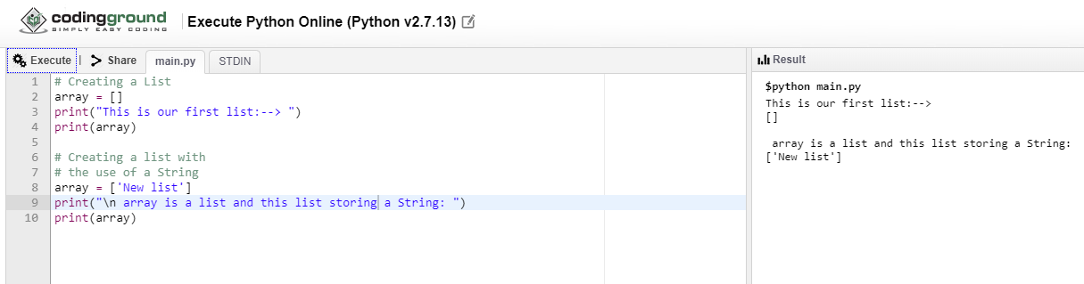
Creating a List

Slide 4
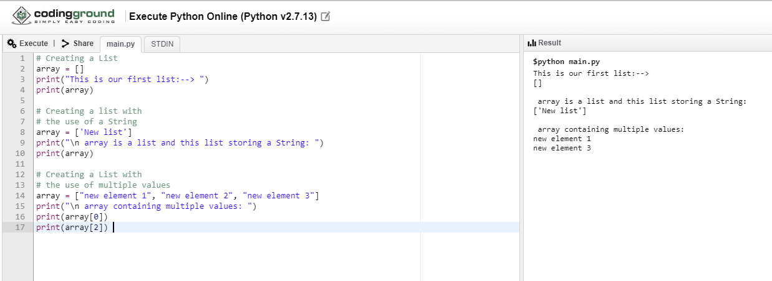
Creating a List with the use of multiple values

Slide 5
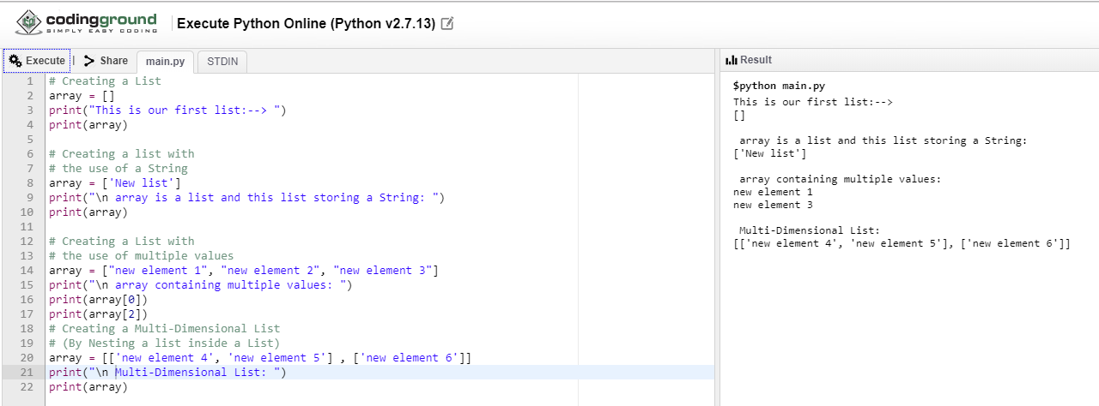
Creating a Multi-Dimensional List Nesting a list inside a List

Slide 6
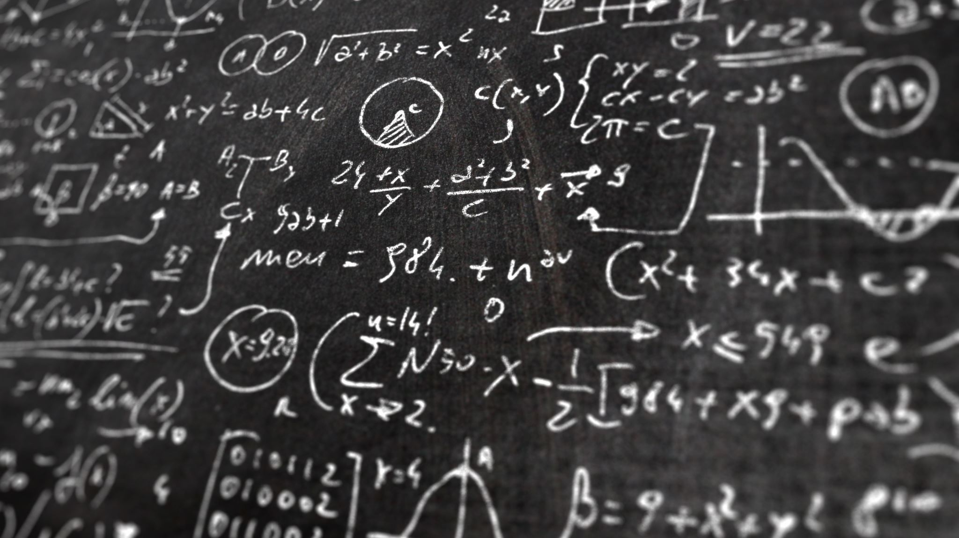
Adding Elements to a List
Elements can be added to the List by using built-in append() function.
Only one element at a time can be added to the list by using append() method, for addition of multiple elements with the append() method, loops are used.
Tuples can also be added to the List with the use of append method because tuples are immutable.

Slide 7
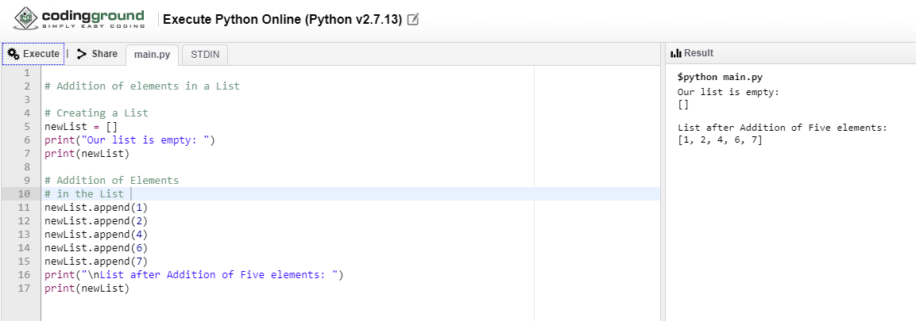
Append()
append() methods can only add elements at the end.

Slide 8
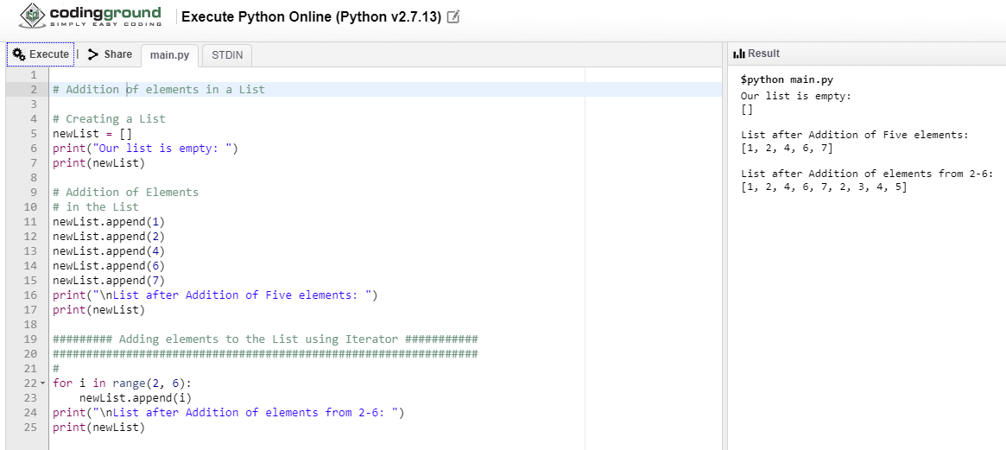
Adding elements to the List using Iterator

Slide 9
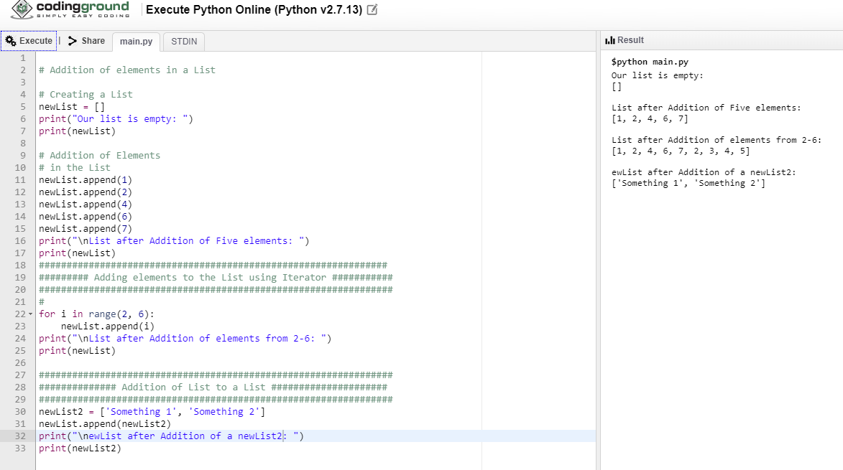
Append a list
Try printing newlist

Slide 10
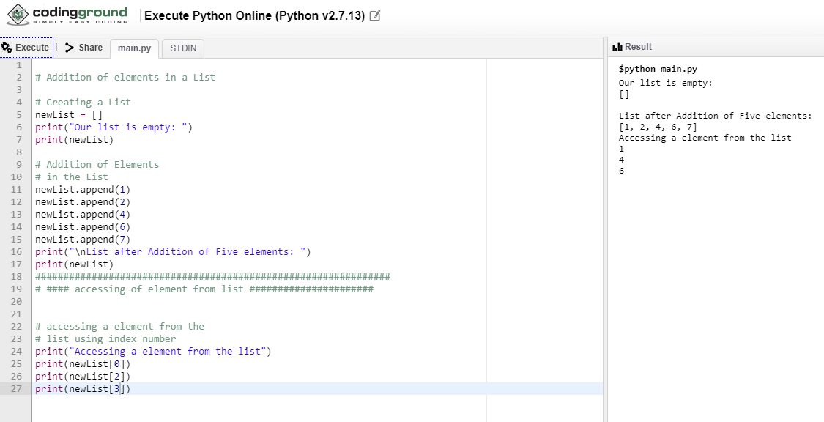
Accessing elements from the List

Slide 11
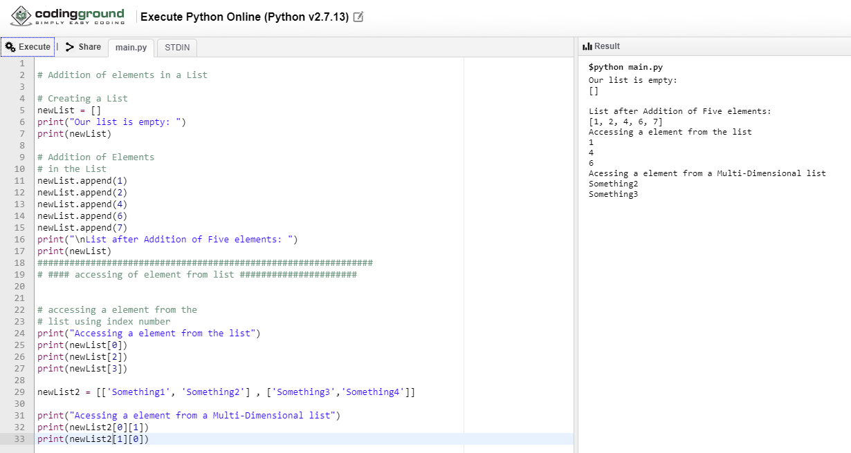
Accessing element from the Multi-Dimensional List using index number

